Slide 1












Minor Trauma Emergency Circuit (MonoTrauma)
Redesign Approach

Slide 2
Context & Objectives
The Problem: Increasing pressure on emergency services; need to optimize patient flow and resource utilization.
The Process: Minor Trauma Emergency Circuit "MonoTrauma" – A distinct pathway for minor orthopedic trauma (limbs/vertebral) designed to reduce waiting times
Project Objectives:
Model the AS-IS process.
Identify inefficiencies (Qualitative & Quantitative Analysis).
Propose an improved TO-BE model supported by simulation and financial evaluation

Slide 3
Theoretical Background (Methodology)
Framework: Full BPM Lifecycle (Identification→Redesign)
Modelling: BPMN 2.0 standards using Bizagi Modeler
Qualitative Analysis:
Value-Added Analysis (VA, BVA, NVA)
Waste Analysis (Move, Hold, Over-do)
Issue Register (Impact assessment)
Quantitative Analysis: Discrete-Event Simulation (Time, Cost, Resources)
Redesign Strategy: Heuristics (Re-sequencing & Parallelism)

Slide 4

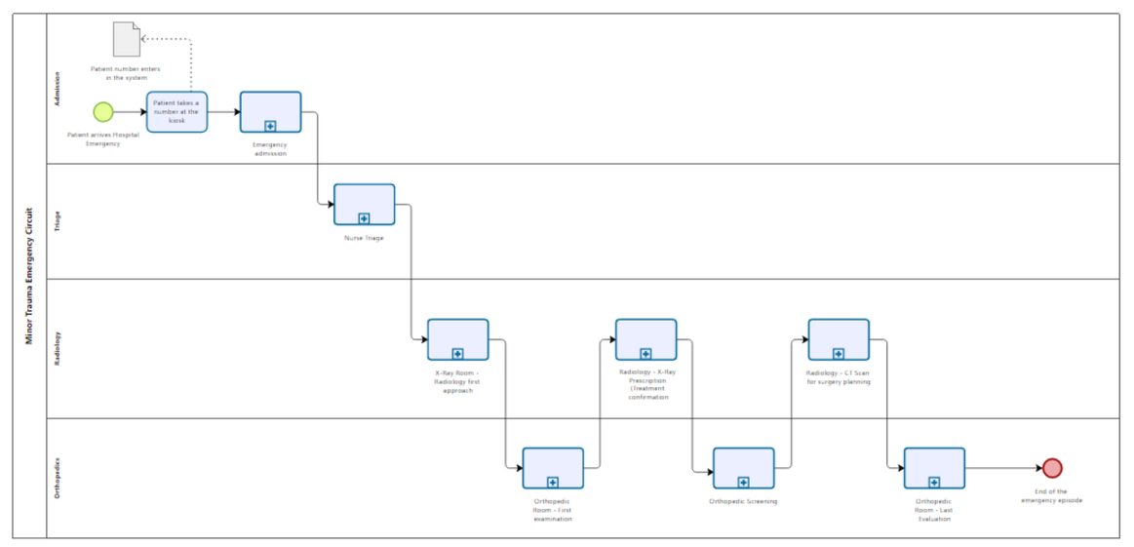
AS-IS Process Modeling
Level 1 Overview: The macro process flows through four main departments: Admission, Triage, Radiology, and Orthopedics.
Detailed Modelling: The process was decomposed into 8 specific sub-processes to capture all operational details:
Admission (Registration & Administrative data).
Triage (Prioritization & MonoTrauma activation).
Radiology: First Approach (Initial X-Ray execution).
Orthopedics: First Evaluation (Diagnosis & Decision).
Radiology: X-Ray Prescriptions (Control exams for treatment confirmation).
Orthopedic Screening (Review of control images).
Radiology: CT Scan (For surgery planning).
Orthopedics: Final Evaluation (Discharge or Surgery Admission)
AS-IS Level 1 diagram
Overview: The process comprises 4 main lanes: Admission, Triage, Radiology, and Orthopedics

Slide 5
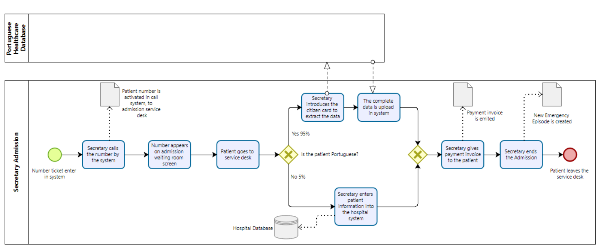
AS-IS Process Modeling
Admission sub-process

Slide 6
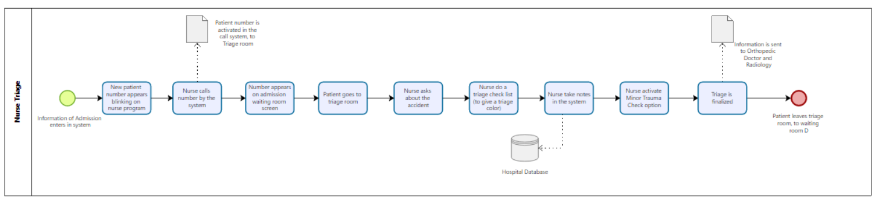
Triage sub-process

Slide 7
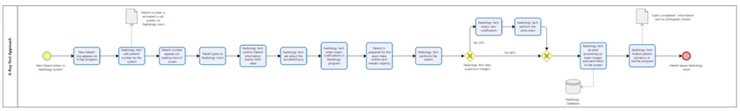
Radiology – first approach sub-process

Slide 8
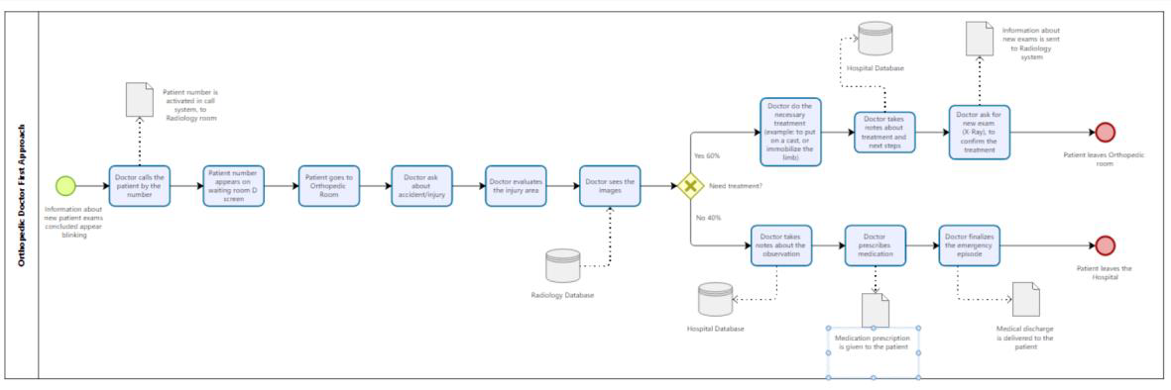
Orthopedics first evaluation sub-process

Slide 9
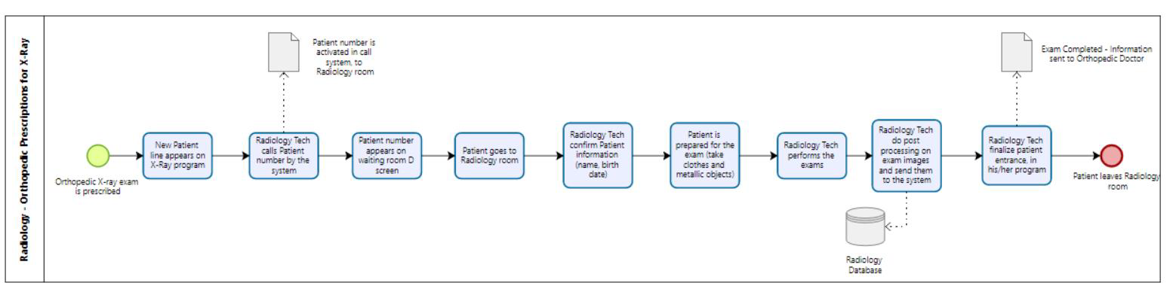
Radiology – X-Ray prescriptions sub-process

Slide 10
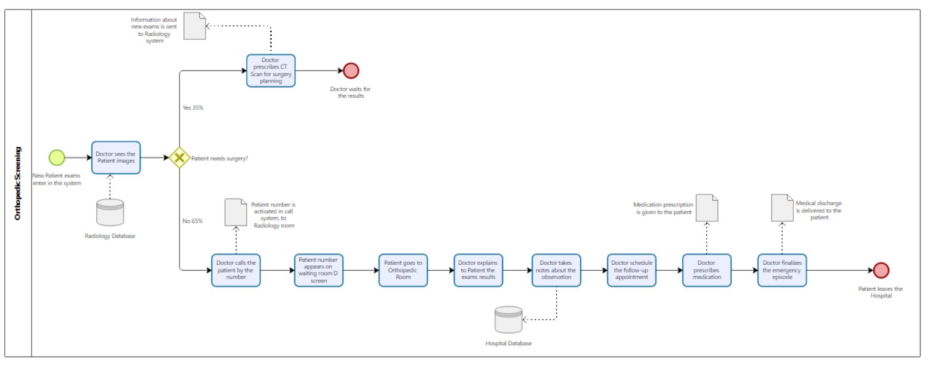
Orthopedic Screening sub-process

Slide 11
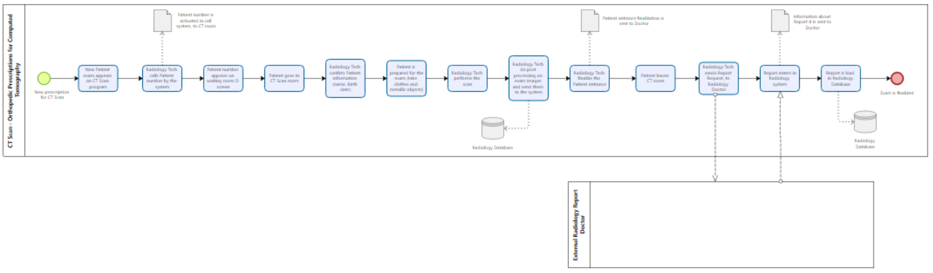
Radiology – CT scan (for surgery planning) sub-process

Slide 12
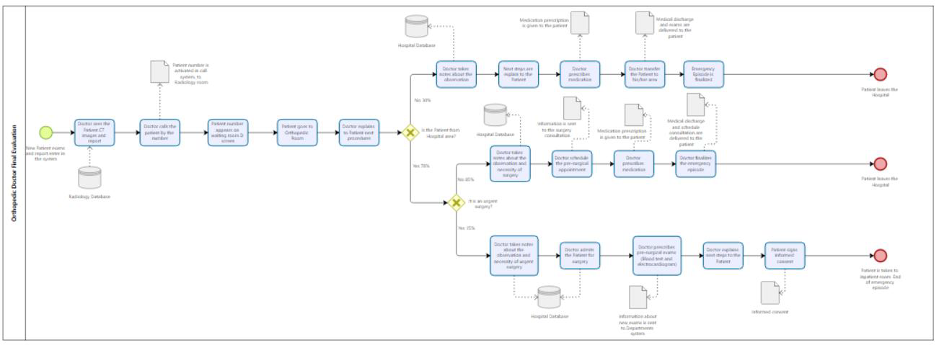
Orthopedy final evaluation sub-process

Slide 13
Qualitative Analysis (Issues Identified)
Value-Added Analysis: The process is patient-centered but contains Non-Value-Adding (NVA) operational waste
External Dependency: Delays due to external CT reporting
Patient Movement: Patients cross departments 4-6 times per visit.
Key Issues (Issue Register):
Excessive Waiting Times: Long waits between clinical stages.
Radiology Bottleneck: Workload concentration and repetitive patient movements

Slide 14
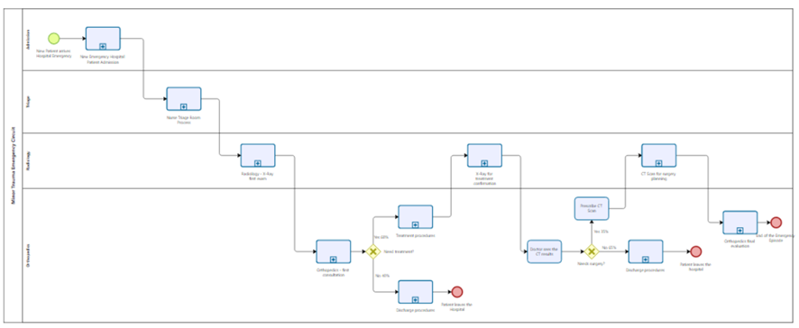
Quantitative Analysis (AS-IS Baseline)
Input Data:
Average of 70 patients/12h shift
Poisson Distribution
Mean arrival rate (λ approx 0.097)
Mean inter-arrival time (1/λ) = 10.3
AS-IS Simulation diagram

Slide 15




Quantitative Analysis (AS-IS Baseline)
Input Data:
4 What-if:
- 1 Receptionist
- 2 Receptionists
+ 1 Doctor
Elimination of taks
Simulation Results:
Throughput: Only 59 of 70 patients complete the process per shift.
Avg. Cycle Time: 2h 14m 24s.
Resource Utilization: High strain on Orthopedists (86.77%) and Radiology Techs (73.26%); Low utilization for Receptionists (23.97%)

Slide 16
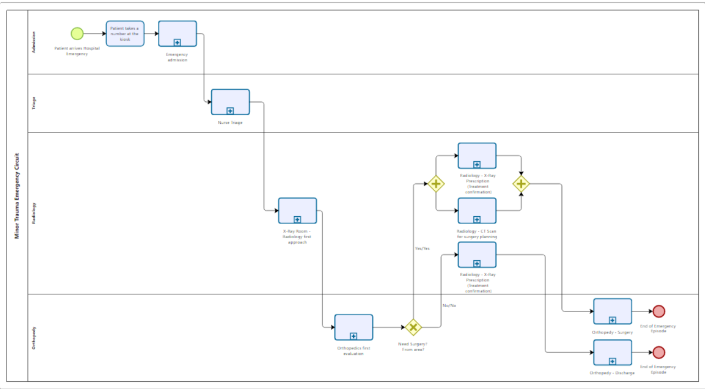
Redesign Heuristics (TO-BE)
Heuristics Applied:
Re-sequencing (Knock-out): Early "Hospital Area" check filters 30% of surgical cases, avoiding unnecessary planning steps .
Re-sequencing (Decision): "Need Surgery?" check moved earlier to skip redundant X-Ray prescriptions .
Parallelism: X-Ray and CT scans now run in parallel for surgical patients, reducing lead time
TO-BE Simulation diagram

Slide 17
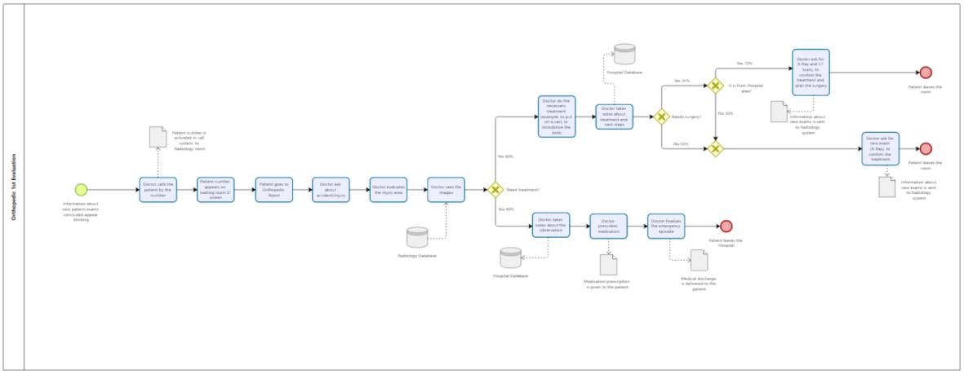
New Sub-processes for the TO-BE model
Due to these flow changes, 3 New Sub-processes were created for the TO-BE model
TO-BE Orthopedy First Evaluation

Slide 18
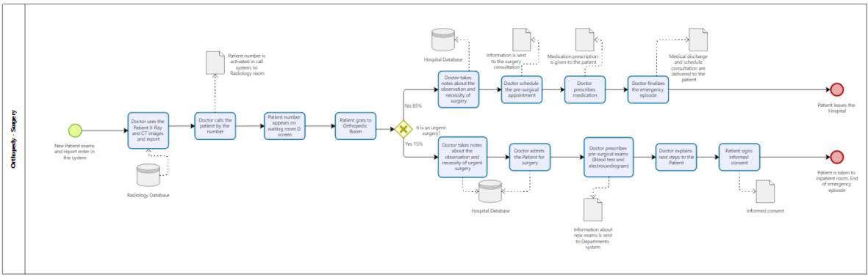
New Sub-processes for the TO-BE model
TO-BE Orthopedy Surgery sub-process

Slide 19
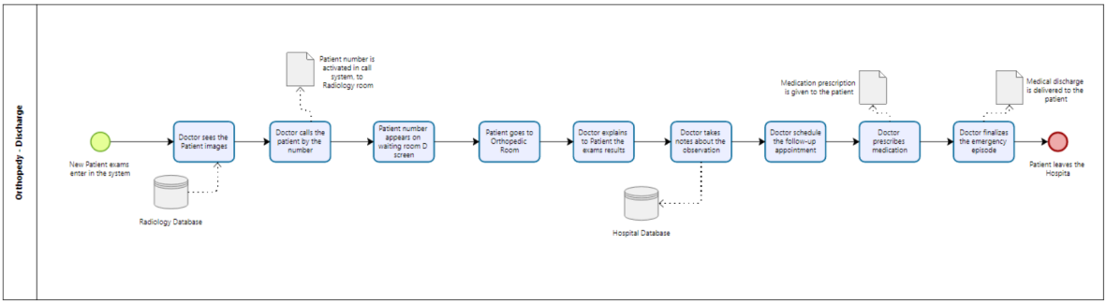
New Sub-processes for the TO-BE model
TO-BE Orthopedy Discharge sub-process

Slide 20
Final Comparison (AS-IS vs. TO-BE)
Cycle Time:
Throughput:
Reduced from 2h 14m (AS-IS) to 1h 14m (TO-BE). Improvement of > 1 hour
Increased from 59 to 68 patients completed per shif
Efficiency:
Optimized resource usage with better flow

Slide 21
Financial Evaluation
Total Cost per Shift:
AS-IS: €956.20
TO-BE: €968.25
Variation: Minimal increase of +€12.05 per shift.
Conclusion: The substantial gain in capacity and speed justifies the marginal cost increase.

Slide 22
Conclusion
BPM Success: The project successfully applied the BPM lifecycle to optimize the Minor Trauma Circuit.
Efficiency Gains: Achieved a ~50% reduction in cycle time and increased capacity through flow redesign and resource adjustment.
Value: Demonstrated that structured process analysis can significantly improve healthcare operations with minimal financial impact

Slide 23
Limitations
Academic Scope: Project limited to Analysis and Redesign phases; Implementation and Control were excluded.
Data Estimation: Simulation relies on estimated averages rather than empirical data.
Resource Focus: Model excludes shared resource constraints (interdependencies) with other hospital departments.
External Constraints: Contractual dependency on external CT reporting could not be altered

